Slide 1


Node.JS
Async development
introduction
September, 2017

Slide 2
Agenda
When and how do we do async functions?
Difference between setTimeout & setInterval in browser and Node.js
How does EventLoop handle async functions in Node.js?
process.nextTick
Async Library

Slide 3


Sync vs async performance
Notes:
“Metaphor”
In simpler terms:
SYNCHRONOUS
You are in a queue to get a movie ticket. You cannot get one until everybody in front of you gets one, and the same applies to the people queued behind you.
ASYNCHRONOUS
You are in a restaurant with many other people. You order your food. Other people can also order their food, they don't have to wait for your food to be cooked and served to you before they can order. In the kitchen restaurant workers are continuously cooking, serving, and taking orders. People will get their food served as soon as it is cooked.

Slide 4
When do we use async functions?
File system
Events
Streams
DataBase operations
Notes:
Node.js itself is single threaded, but some tasks can run parallelly - thanks to its asynchronous nature.
But what does running parallelly mean in practice?
Since we program a single threaded VM, it is essential that we do not block execution by waiting for I/O, but handle them concurrently with the help of Node.js's event driven APIs.

Slide 5
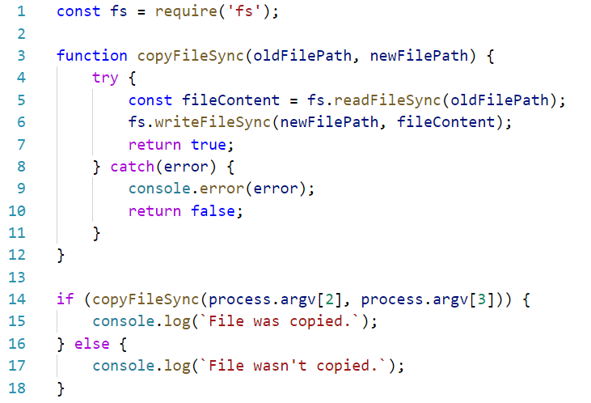
Sync functions

Slide 6
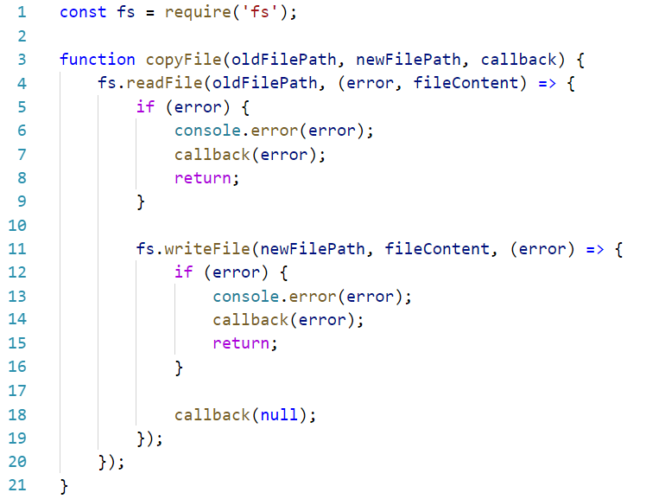
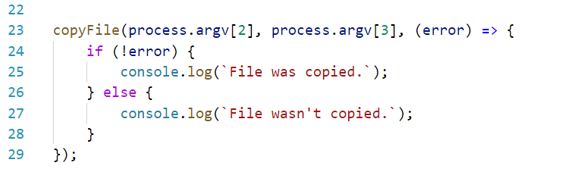
Using callbacks

Slide 7
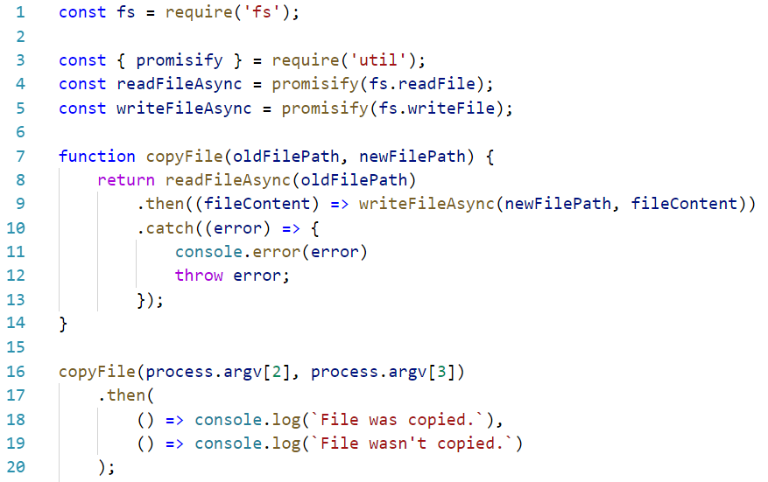
Promises

Slide 8
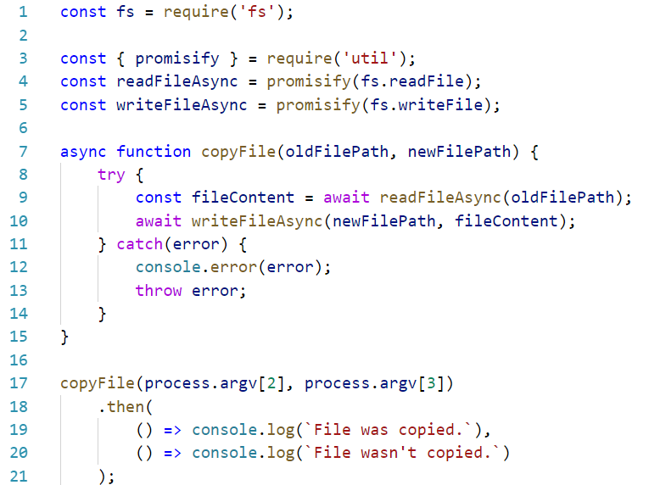
Async functions

Slide 9
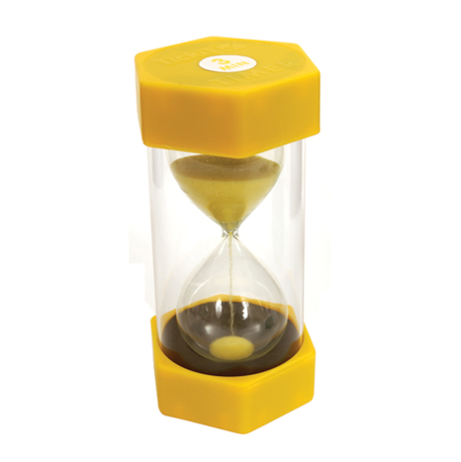
Timers & setImmediate
setTimeout(callback, delay[, ...args])
clearTimeout(timeout)
setInterval(callback, delay[, ...args])
clearInterval(timeout)
setImmediate(callback[, ...args])
clearImmediate(immediate)

Slide 10
Timers ref/unref
Node app keeps running in case there are any watch-process like server listening or interval.
You can use timerObject.unref to mark timer as non-priority, so app can be closed without waiting until the interval is cleared.

Slide 11
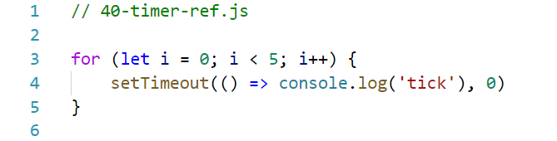
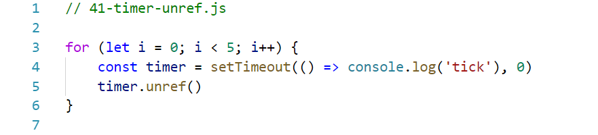
Timers ref/unref Demo

Slide 12
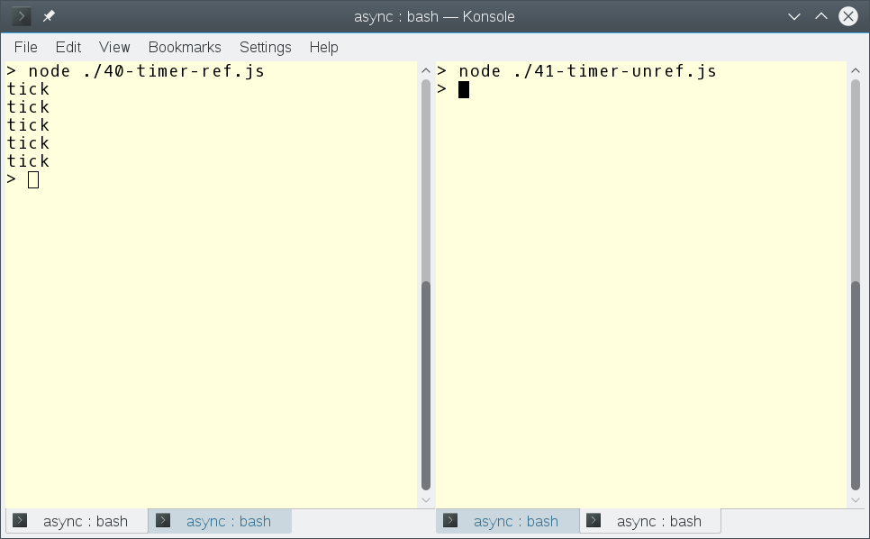
Timers ref/unref demo

Slide 13
setTimeout vs setImmediate
setTimeout() schedules a script to be run after a minimum threshold in ms has elapsed.
setImmediate() is designed to execute a script once the current poll phase completes.

Slide 14
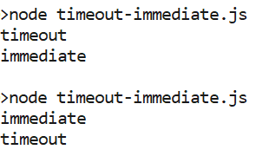
setTimeout vs setImmediate

Slide 15
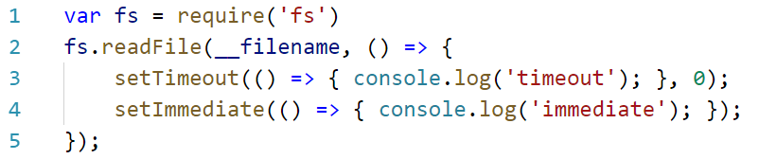
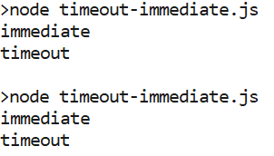
setTimeout vs setImmediate

Slide 16

Event loop
The event loop is what allows Node.js to perform non-blocking I/O operations — despite the fact that JavaScript is single-threaded — by offloading operations to the system kernel whenever possible.

Slide 17
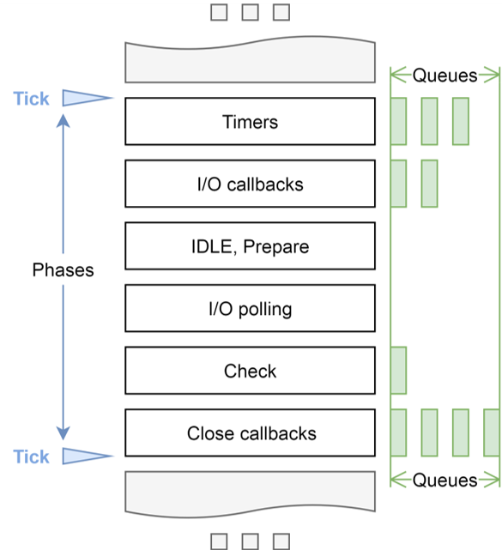
EventLoop phases
The event loop as a process is a set of phases with specific tasks that are processed in a round-robin manner.
Notes:
Dispatch in chronological order:
timer handles (drives setTimeout / setInterval)
idle handles (these are pretty much irrelevant to node.js code)
prepare handles (ditto)
I/O callbacks (includes polling for new events, may block if no work is queued)
check handles (drives setImmediate)
handle close callbacks

Slide 18
process.nextTick
process.nextTick(callback[, ...args])
The process.nextTick() method adds the callback to the "next tick queue". Once the current turn of the event loop turn runs to completion, all callbacks currently in the next tick queue will be called.
Notes:
Where's process.nextTick()? Basically after each of the above steps

Slide 19
NextTick

Slide 20
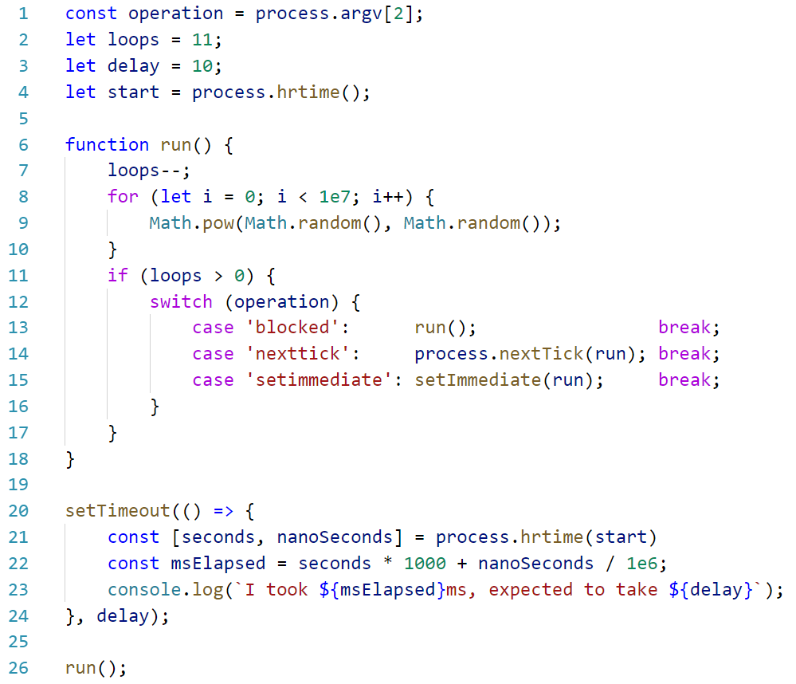
NextTick vs setImmediate

Slide 21
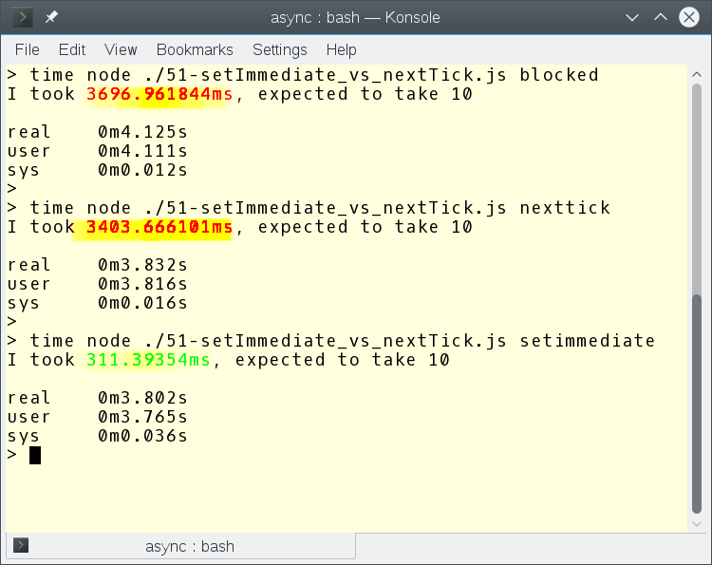
NextTick vs setImmediate

Slide 22

Async Library
http://caolan.github.io/async/

Slide 23
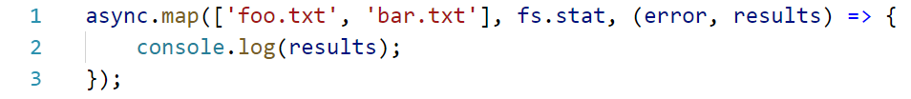
Async Library
http://caolan.github.io/async/

Slide 24
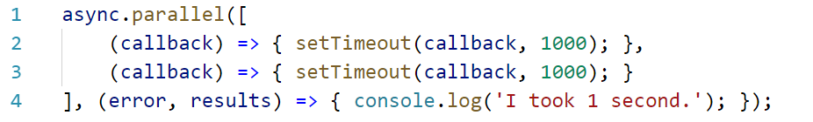
Async Library
http://caolan.github.io/async/

Slide 25
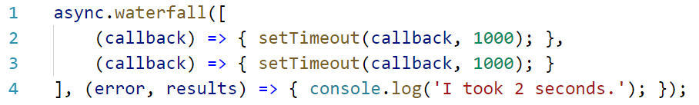
Async Library
http://caolan.github.io/async/

Slide 26
NODE.JS GLOBAL
Node.js. Async Development. Introduction
BY Viktor Kukharev Konstantin Khvalin

